Slide 1
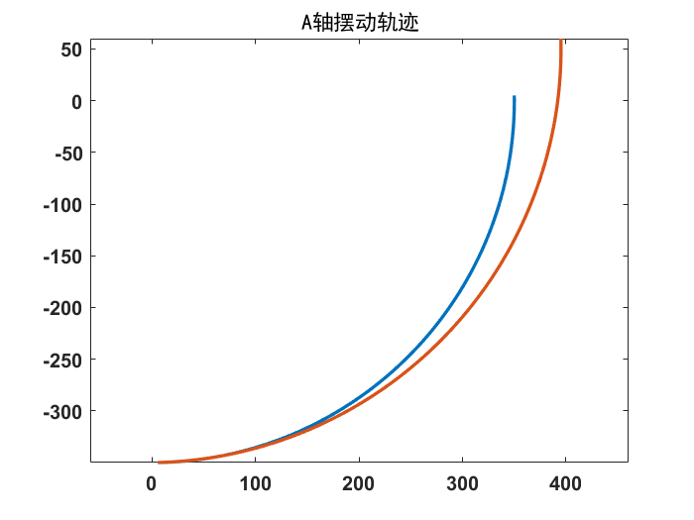
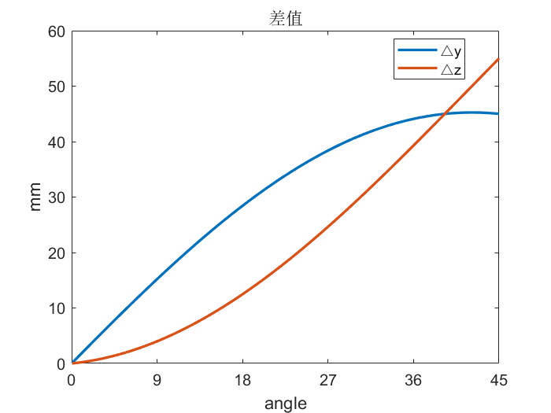






$$\left[\begin{matrix}cosθ & −sinθ \\ sinθ & cosθ\end{matrix}\right]\left[\begin{matrix}x \\ y\end{matrix}\right]+\left[\begin{matrix}x_{0}−x \\ y_{0}−y\end{matrix}\right]=\left[\begin{matrix}cosθ & −sinθ \\ sinθ & cosθ\end{matrix}\right]\left[\begin{matrix}x_{0} \\ y_{0}\end{matrix}\right]+\left[\begin{matrix}∆x \\ ∆y\end{matrix}\right]$$
$$\left\lfloor \begin{matrix}cosθ−1 & −sinθ \\ sinθ & cosθ−1\end{matrix}\right\rfloor \left[\begin{matrix}x−x_{0} \\ y−y_{0}\end{matrix}\right]=\left[\begin{matrix}∆x \\ ∆y\end{matrix}\right]$$
$$x$$
摆偏差值
所测差值
$$x_{0}$$
$$y$$
$$y_{0}$$
$$O$$

Slide 2
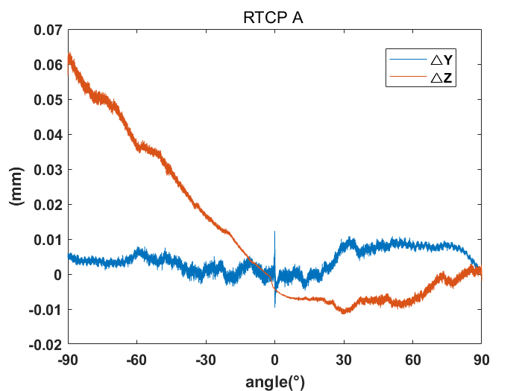
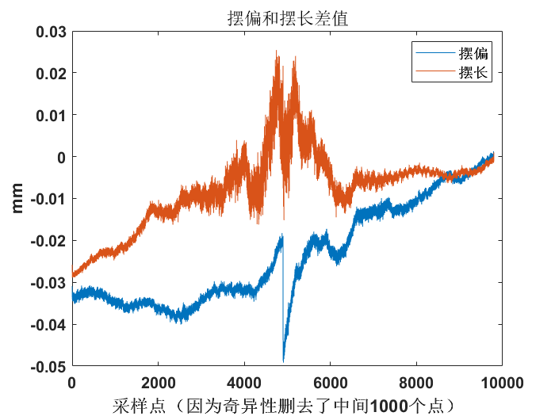
中间值因为矩阵奇异性并不准确

Slide 3
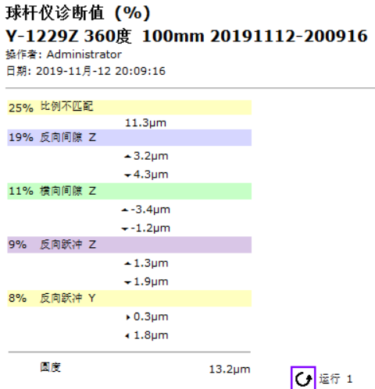
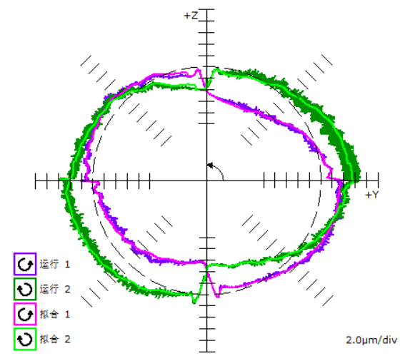
Y-1229

Slide 4
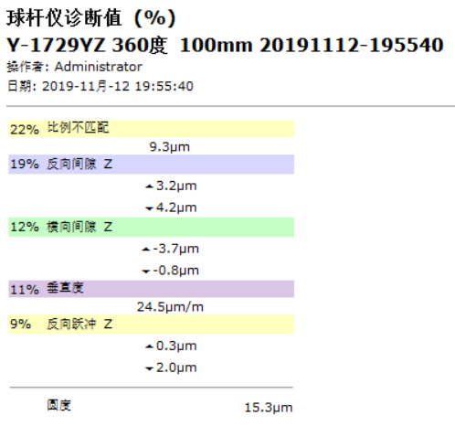
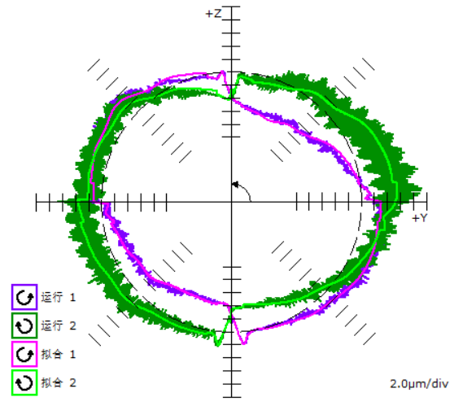
Y-1729

Slide 5
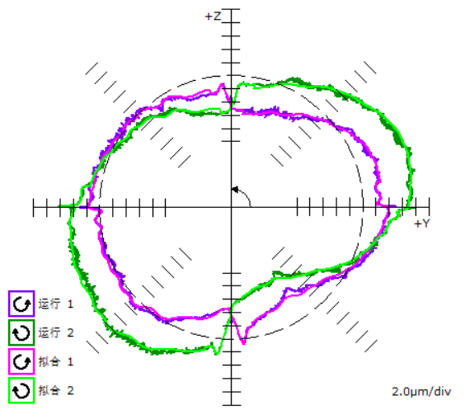
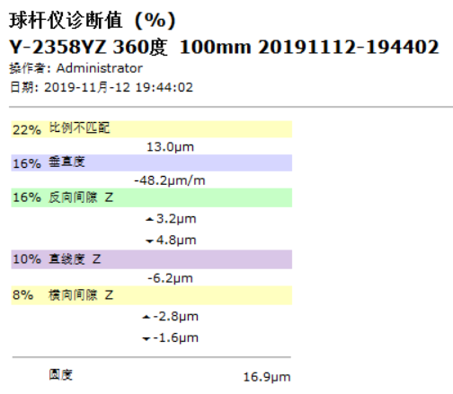
Y-2358

